Slide 1
BEYOND MFA
Strengthening Microsoft 365 Security in a Zero Trust World
Troy Poulin – The Claxton Bank

Slide 2

The New Perimeter
The numbers make one thing clear: identity is the new attack surface. With stolen credentials involved in nearly a quarter of breaches and the human element in over half, protecting identity has become mission-critical.
22%
60%
Identity Based
Human Element
2025 Verizon DBIR
Evolving Identity Attack Techniques

Slide 3



How identities are stolen
And what we can do about it
The Agenda
Post exploitation
These slides are packed with resources — from articles and blog posts to PowerShell scripts, tools, and reference notes. My goal is for you to leave with something you can use right away, and you’ll have full access to this deck and everything in it after the session.
And how we can detect and limit it
MS365 hardening
Why the defaults aren’t enough

Slide 4

Who IS THIS GUY
Troy A. Poulin
Chief Information Officer - The Claxton Bank
Troy Poulin is a seasoned banking executive with more than a decade of experience leading technology, operations, and risk management in the community banking sector. As Chief Information Officer of The Claxton Bank, he oversees the bank’s IT strategy, infrastructure, cybersecurity, and regulatory compliance programs. His work focuses on strengthening security controls, improving operational efficiency, and ensuring alignment with FFIEC, FDIC, and state regulatory expectations. Troy earned his Finance degree from the University of Georgia, graduated from the Georgia Banking School at UGA, and is currently attending the ABA Stonier Graduate School of Banking at the Wharton School of the University of Pennsylvania. Actively engaged in Georgia’s banking community, Troy supports multiple industry associations and serves on several committees and leadership boards focused on technology, marketing, and community banking. He has presented at numerous conferences, sharing insights on technology strategy, cybersecurity, and operational efficiency.
https://www.linkedin.com/in/troyapoulin

Slide 5


How Identities Are Stolen
Prior Breaches
Info Stealers
AiTM / Evil Proxy
(Credential Reuse)
(Malware & Dumping)
(Session/Token Hijacking)
1 , 2
1, 2, 3, 4, 5
Strong Passwords
Banned Password Lists
No Password Reuse
Breach Feed Monitoring
AV/EDR
No Personal Devices
Limit Chrome Extensions
Application Whitelisting
Breach Feed Monitoring
Good MFA ₁
Bonus: Locking Down Chrome Extensions

Slide 6
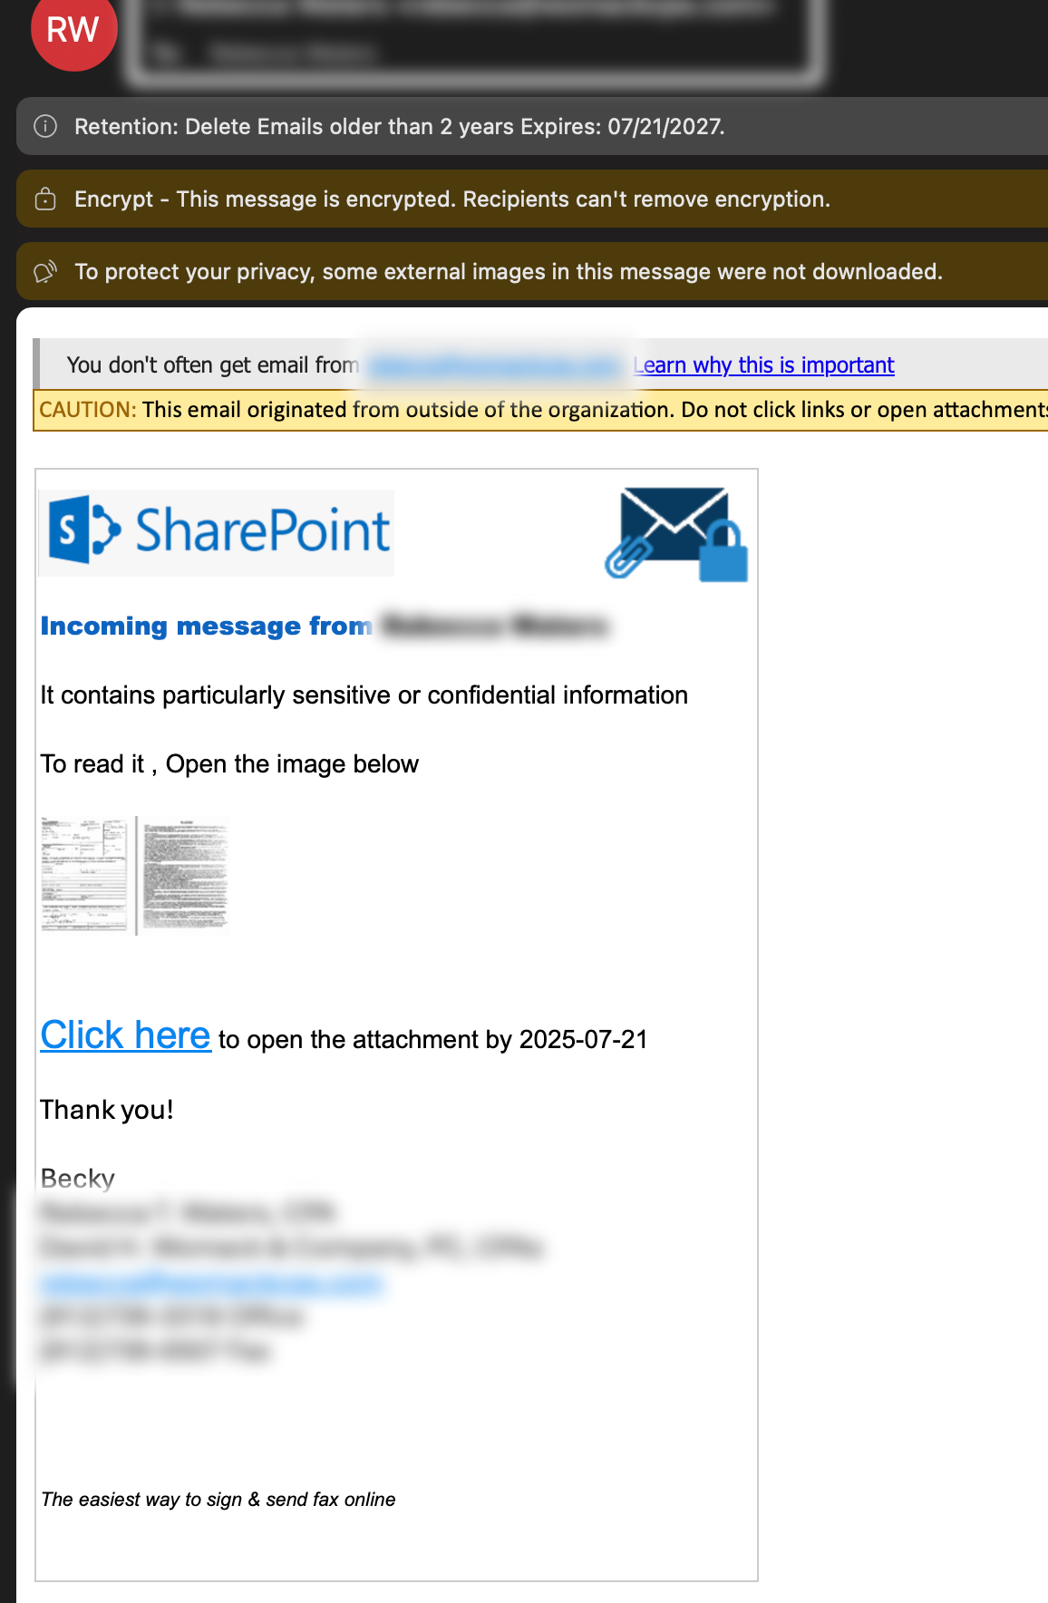
Quick Side Rant
Phishing awareness training and testing is not a security
control
Understanding Open Redirects

Slide 7
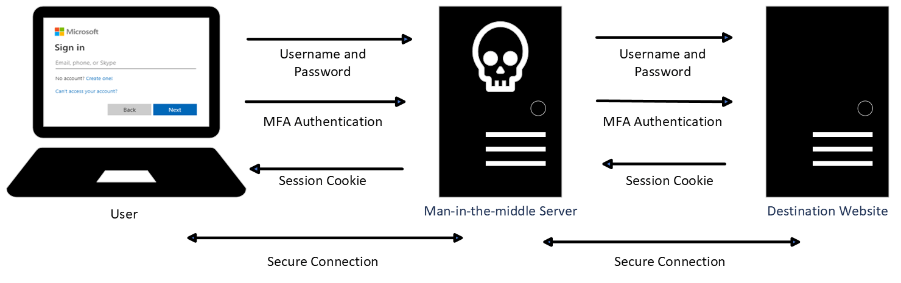


Anatomy of AiTM Attacks
Proxy Based
Browser Based
Manual Based
Evilginx & Modlishka
CuddlePhish & EvilNoVNC
SMS, Support Chat, etc

Slide 8
What do these all have in common?
The URL in the address bar will ALWAYS be different.
The actual login will ALWAYS come from the attacker’s computer.

Slide 9
So How Do We Prevent This?
Block or Detect Proxy Redirect Patterns
Use Phish-Resistant MFA
Have Good Conditional Access Policies in Place

Slide 10
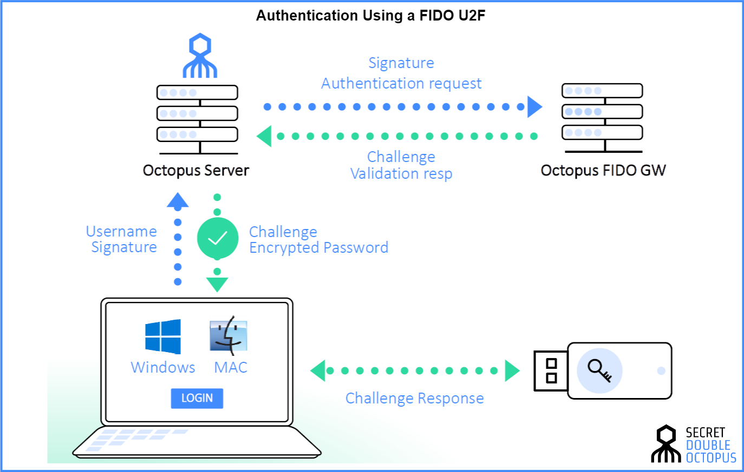
Phish Resistant MFA
Fido2 Authentication | Passkeys | WebAuthn

Slide 11
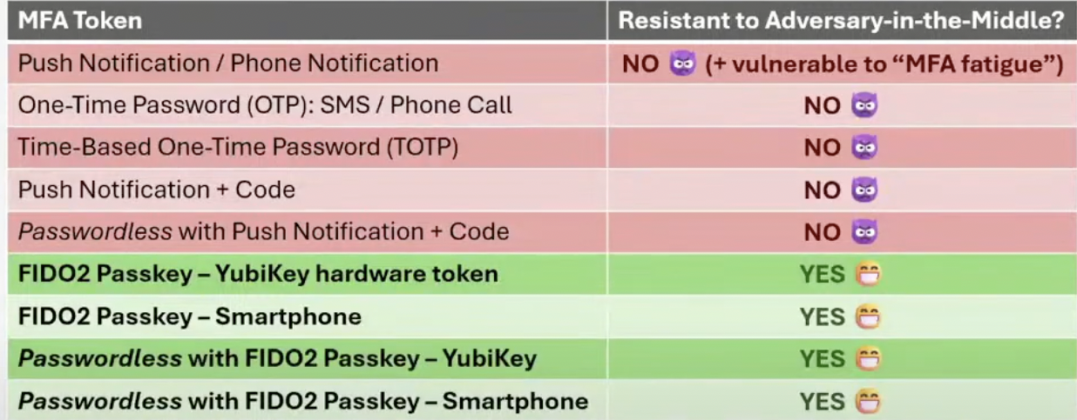
Phish Resistant MFA
Source: How to Test Adversary-in-the-Middle Without Hacking Tools w/ Michael Allen

Slide 12
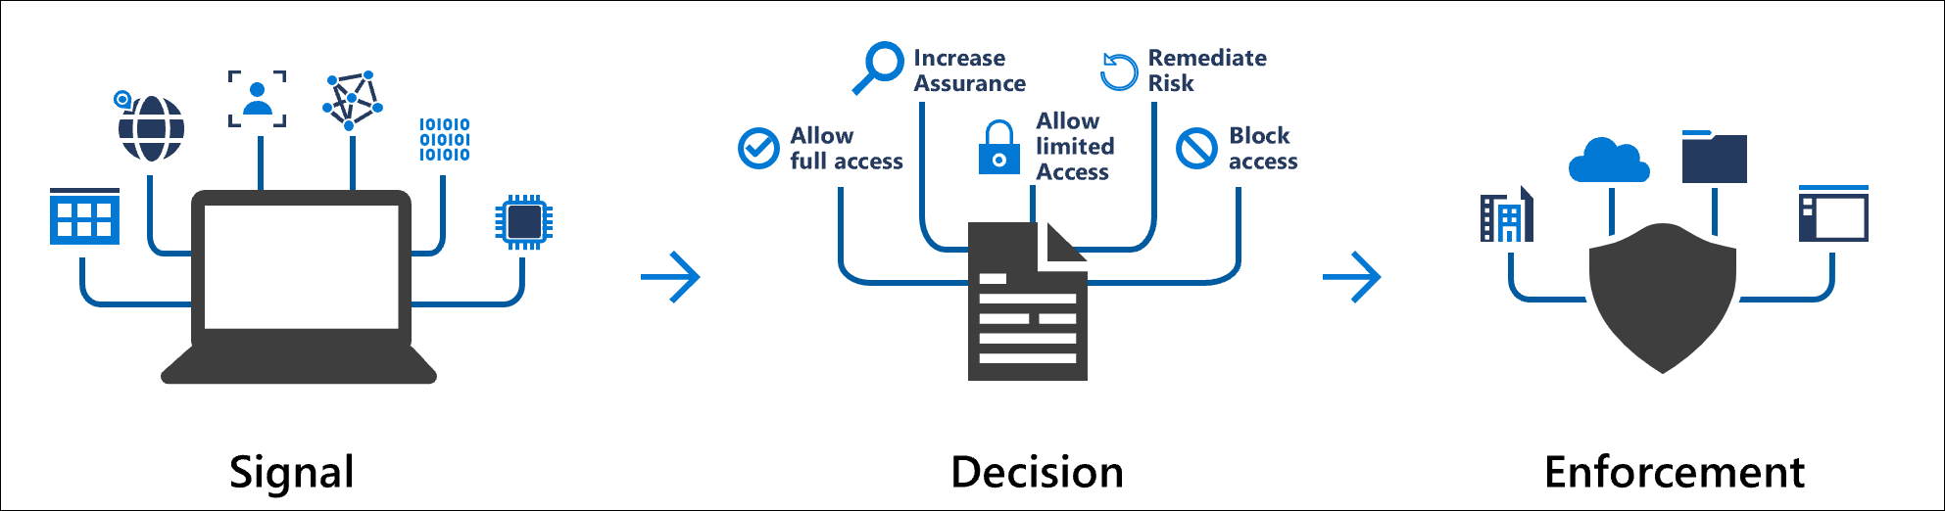
Conditional Access Policies

Slide 13
Conditional Access Policies
Block Legacy Auth and enforce MFA
Block unused device types
Block untrusted locations
Enforce hybrid or cloud joined
Require Intune and device compliance

Slide 14
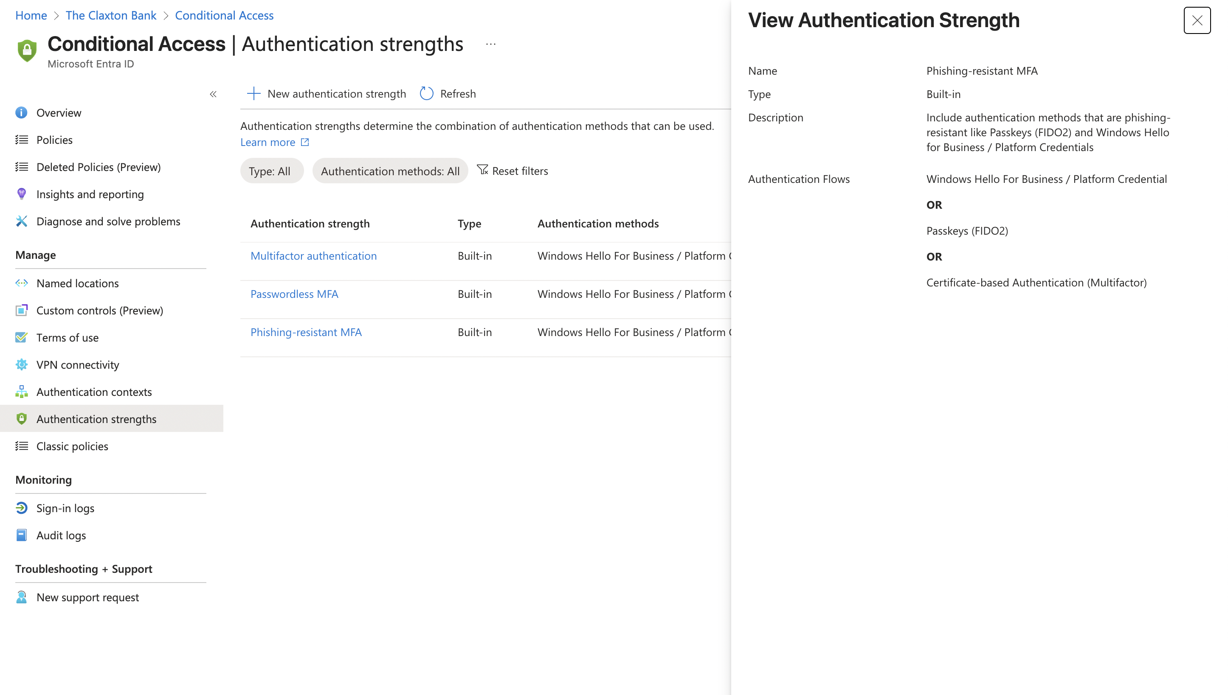
Conditional Access Policies
MS Learn: Conditional Access Aucccccbrvhknkilevkjfklnggfedcdkfteifhinggglbu
th Strengths

Slide 15
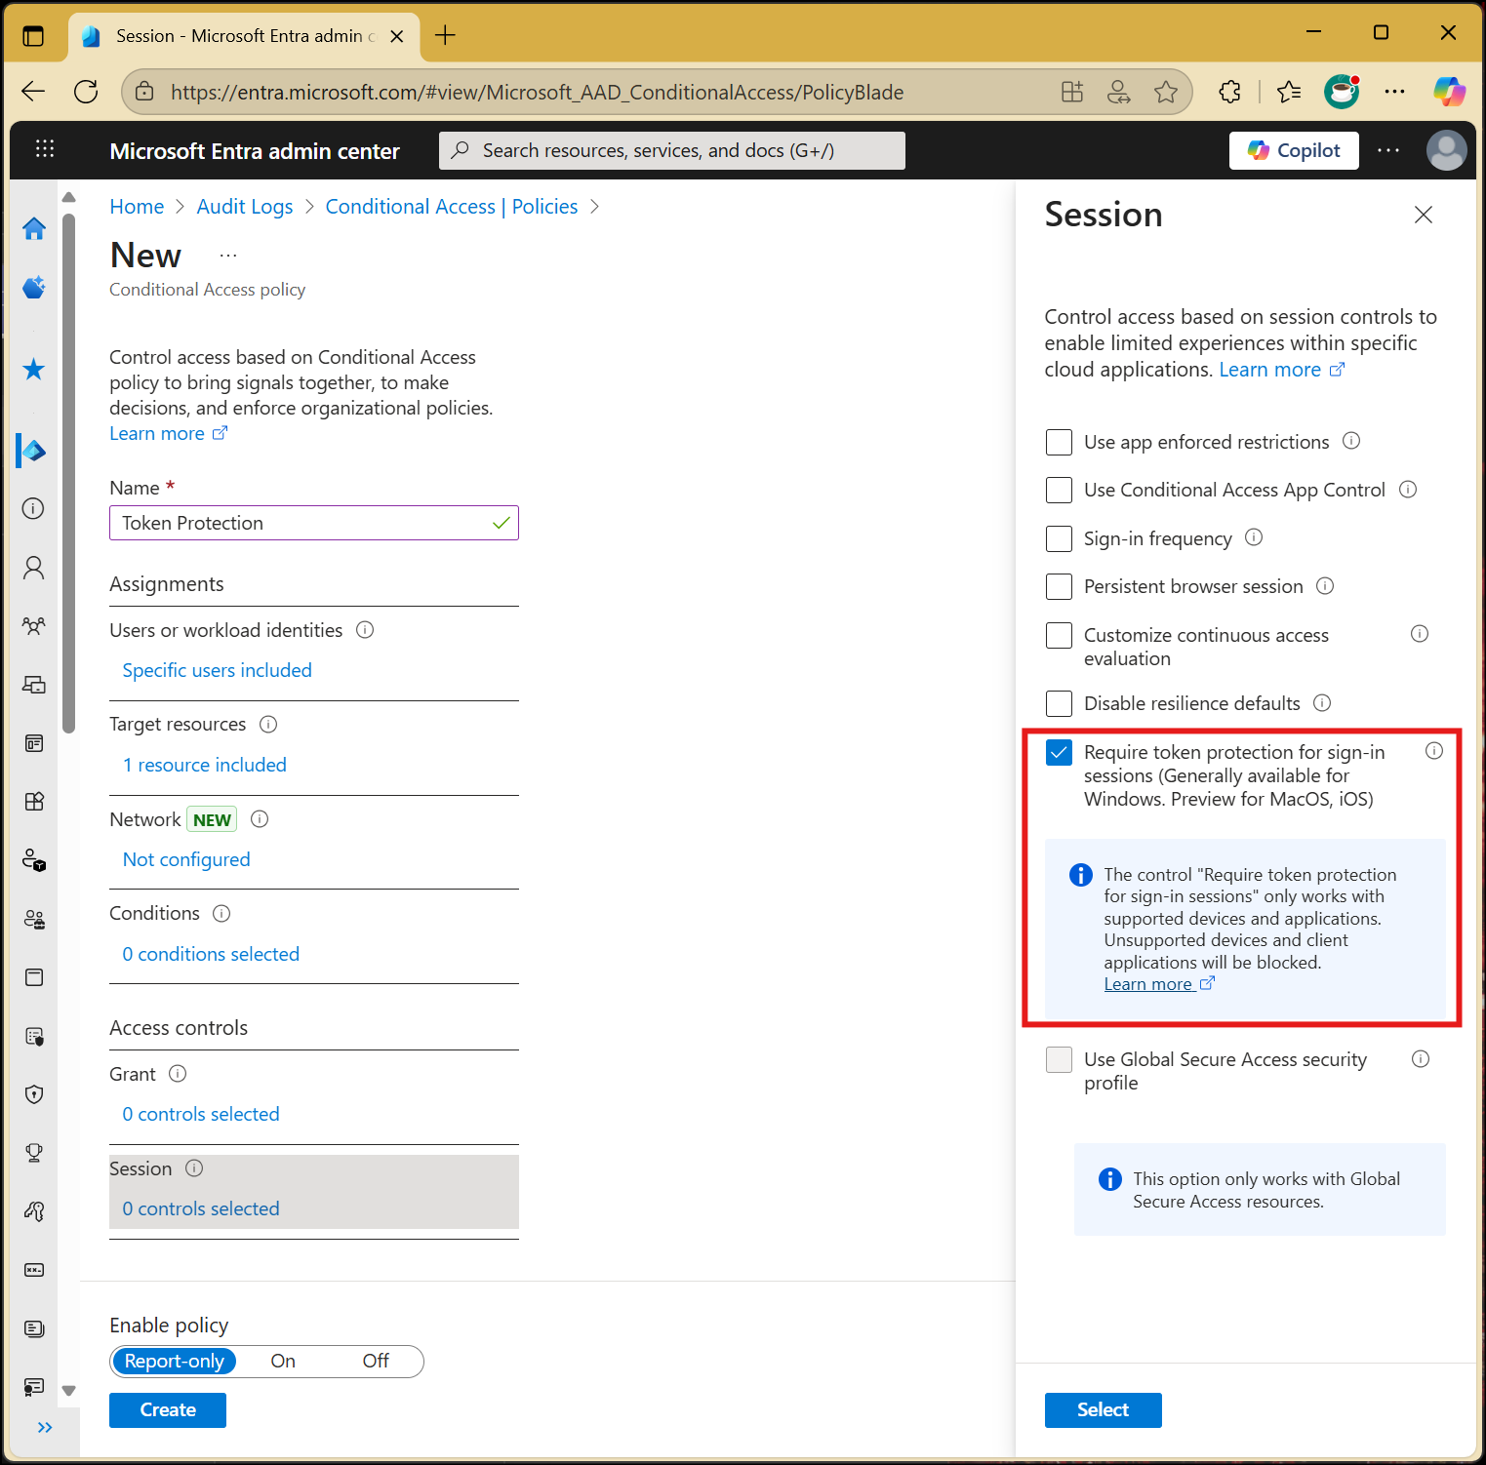
Conditional Access Policies
MS Learn: Conditional Access Token Protection

Slide 16
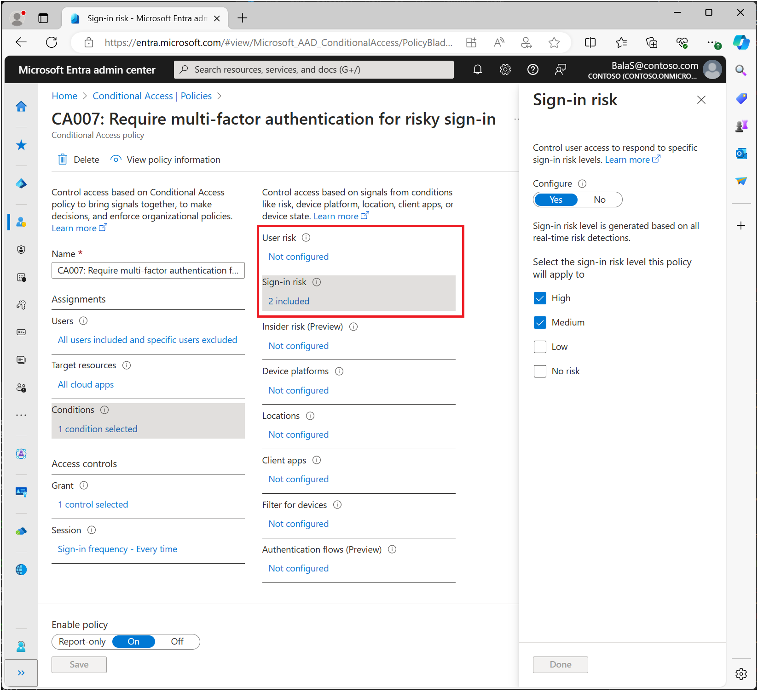
Conditional Access Policies
MS Learn: Conditional Access Risk Policies

Slide 17
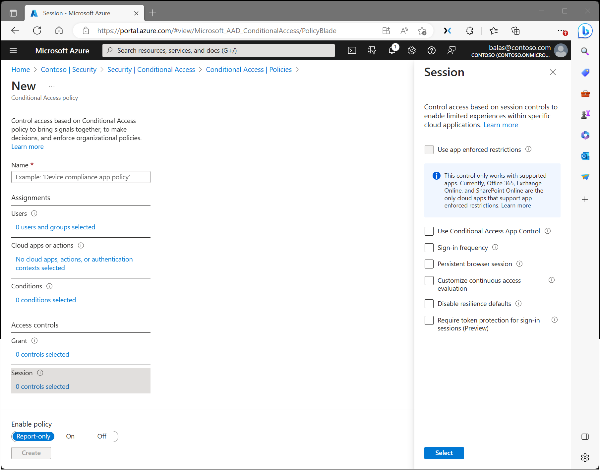
Conditional Access Policies
MS Learn: Conditional Access Session

Slide 18
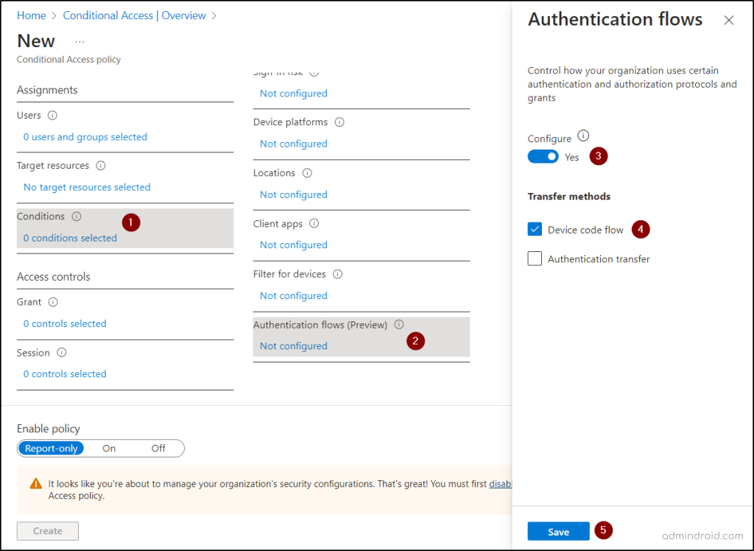
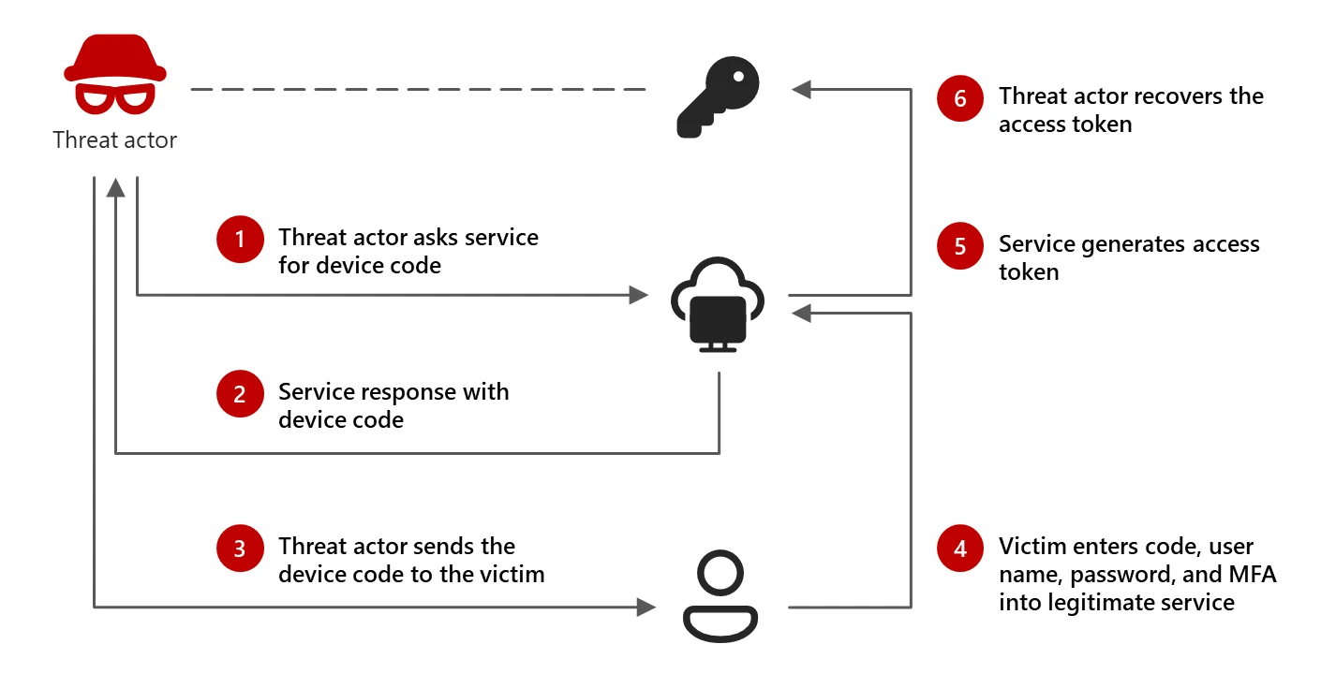
Conditional Access Policies
MS Learn: Conditional Access Auth Flows
How to Restrict Device Code Flow

Slide 19
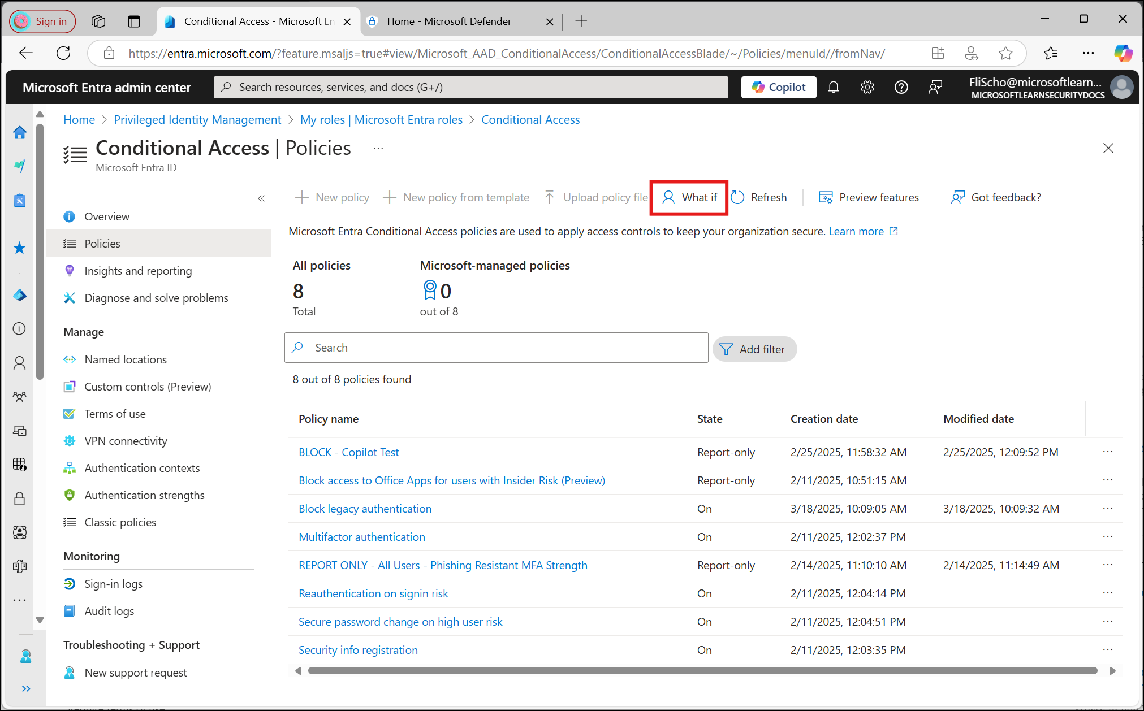
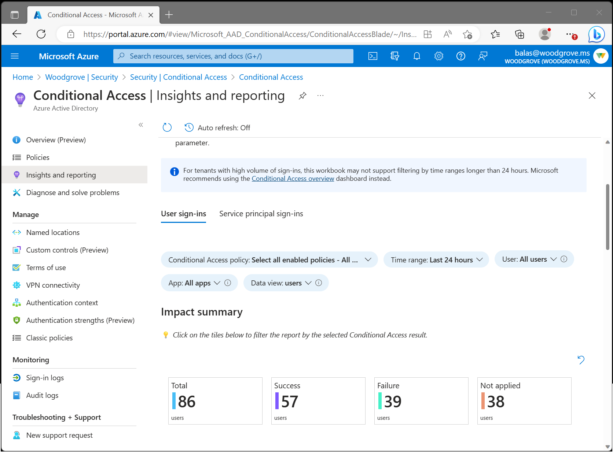
Auditing & Reviewing Polices
Bonus: Other Tooling

Slide 20
Post exploitation
And how we can detect and limit it

Slide 21
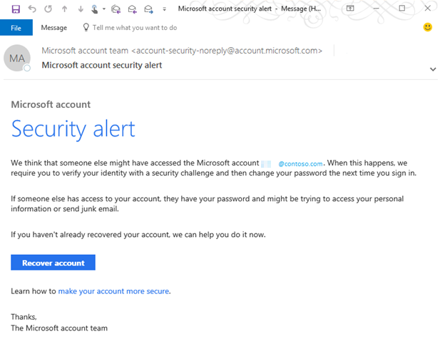
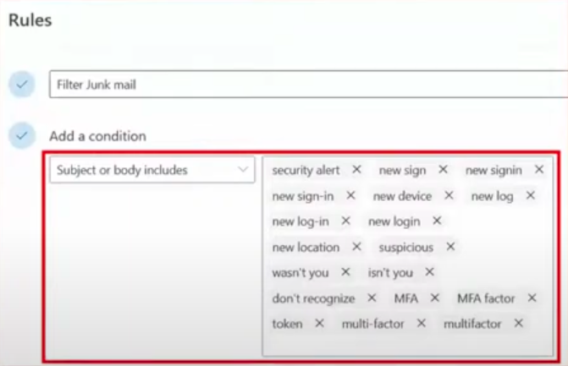
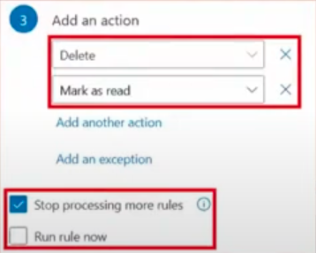
Step 1: Prevent User Alerts
Bonus: Setting up Email Rule Alerts

Slide 22
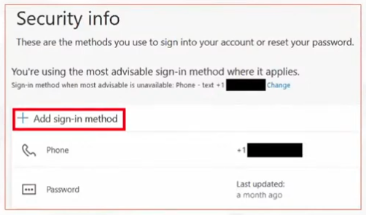
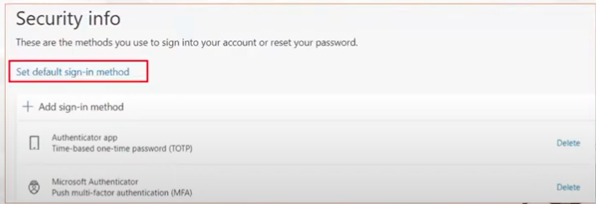
Step 2: Add MFA Token
Bonus: Blocking MFA

Slide 23
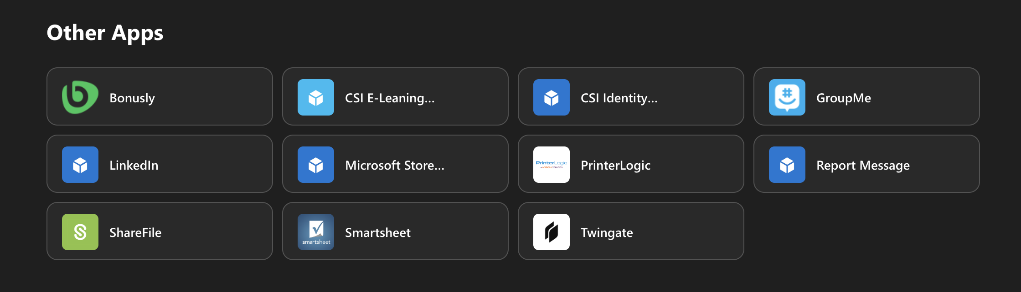
Step 3: Check for Internal Network Access & Other Apps

Slide 24
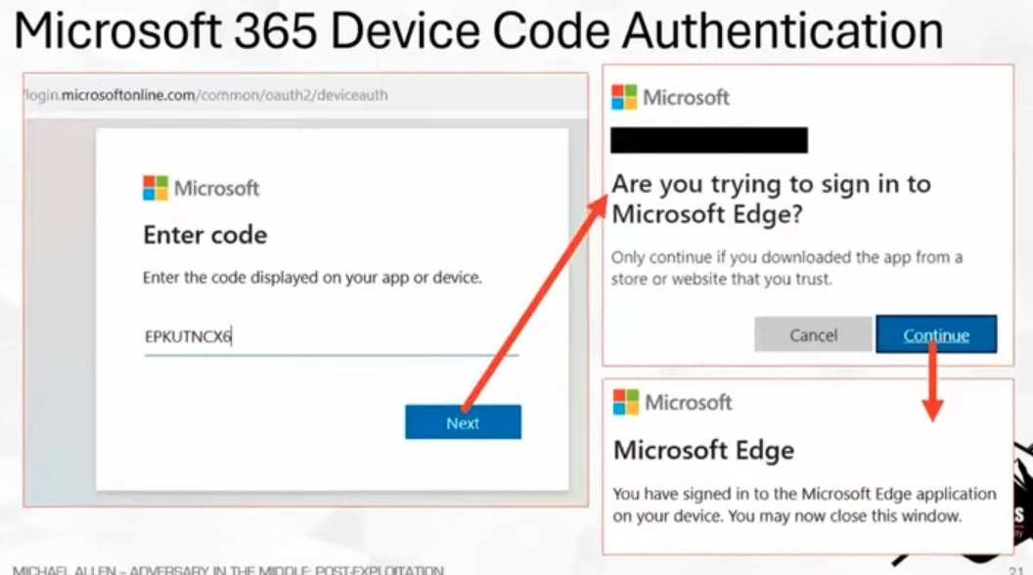
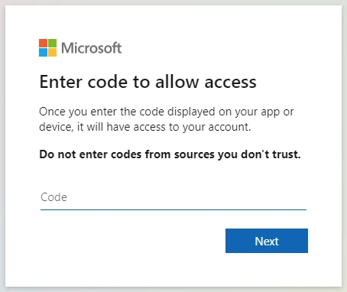
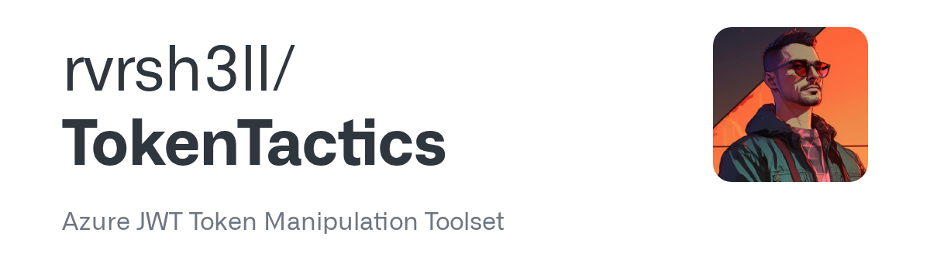
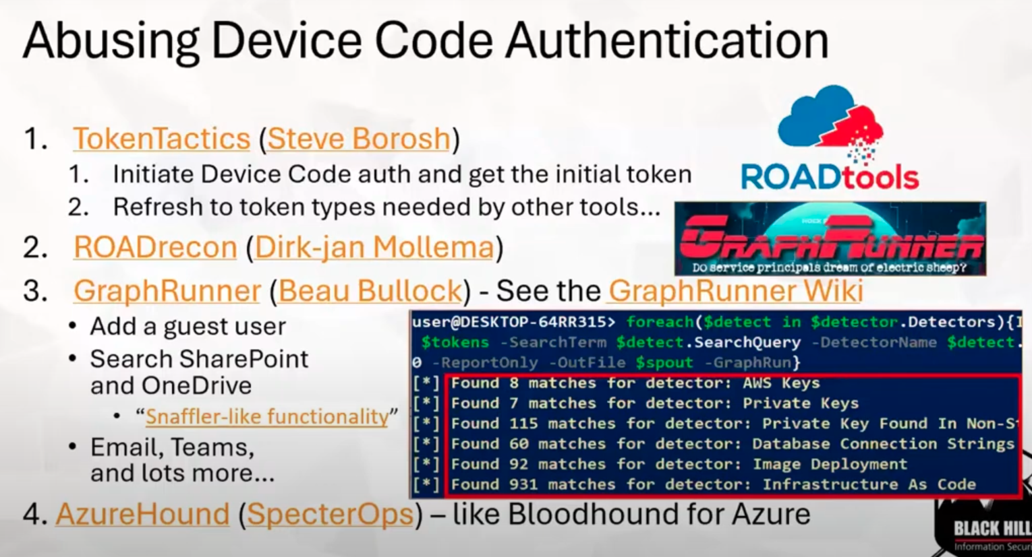


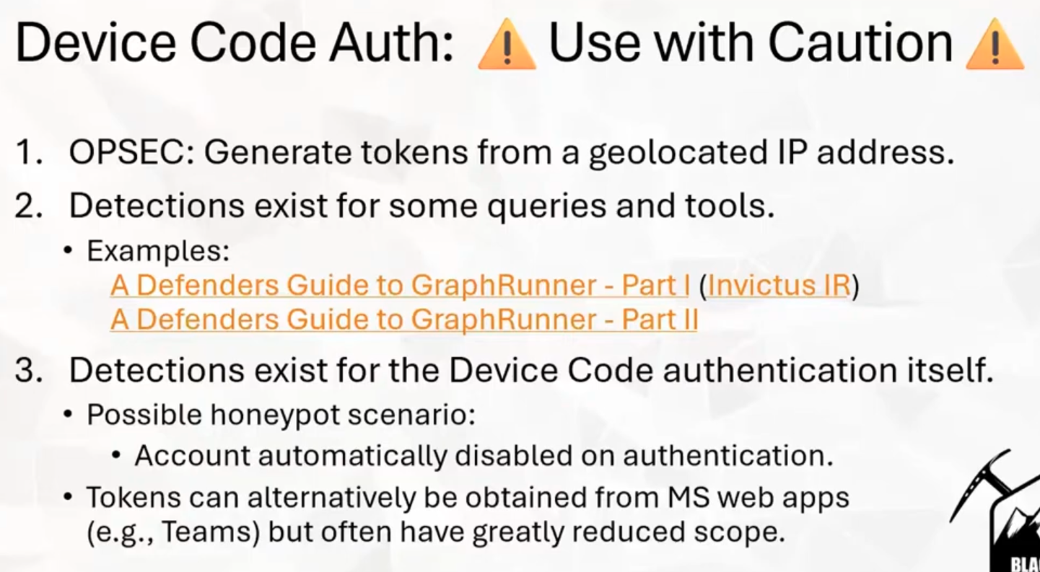
Step 4: Device Code Access

Slide 25
MS365 hardening
Why the defaults aren’t enough

Slide 26
1. Disable User Consent for Enterprise App Registrations
Why: By default, any user can consent to third-party apps that request access to org data (OAuth). This is one of the most exploited vectors (e.g., malicious OAuth apps).
Fix:
Entra ID → Enterprise Applications → Consent and permissions → User consent settings → Do not allow user consent.
Instead, enable an admin consent workflow.
CIS: 2.1.3 “Restrict user consent for applications”

Slide 27
2. Block Self-Service Application Registration
Why: Prevents normal users from registering their own Azure AD applications, which could be abused to exfiltrate data or impersonate services.
Fix:
Entra ID → User Settings → App registrations → “Users can register applications” → No.
CIS: 2.1.4 “Restrict users from registering applications”

Slide 28
3. Restrict Guest Access & External Collaboration
Why: By default, M365 tenants allow guests to be invited and access Teams, SharePoint, and files broadly.
Fix:
Entra ID → External Identities → External collaboration settings → Disable guest self-invite, restrict domain list.
SharePoint Admin → Sharing → “Only people in your organization”.
CIS: 2.4.1 “Restrict external collaboration”

Slide 29
4. Restrict PowerShell and Graph API Access
Why: Any user can authenticate to Exchange Online PowerShell, AzureAD, or MS Graph by default — even without admin roles. Attackers can abuse this for discovery or persistence.
Fix:
Use Conditional Access to limit PowerShell and Graph API logins to admins only.
SharePoint Admin → Sharing → “Only people in your organization”.
Exchange: Set-OrganizationConfig -DefaultRoleAssignmentPolicy "RestrictedUserPolicy"
CIS: 3.4 “Restrict management interface access”

Slide 30
5. Restrict Access to Admin Portals
Why: Non-admin users can still access certain admin endpoints (e.g., admin.microsoft.com, security.microsoft.com) with limited visibility — but attackers can use these for reconnaissance.
Fix:
Use Conditional Access → Require admin roles to access admin portals only.
CIS: 4.1 “Limit administrative interfaces”

Slide 31
thank you
EMAIL: tpoulin@tcbga.bank | LINKEDIN: troyapoulin | GITHUB: troyapoulin

